Slide 1

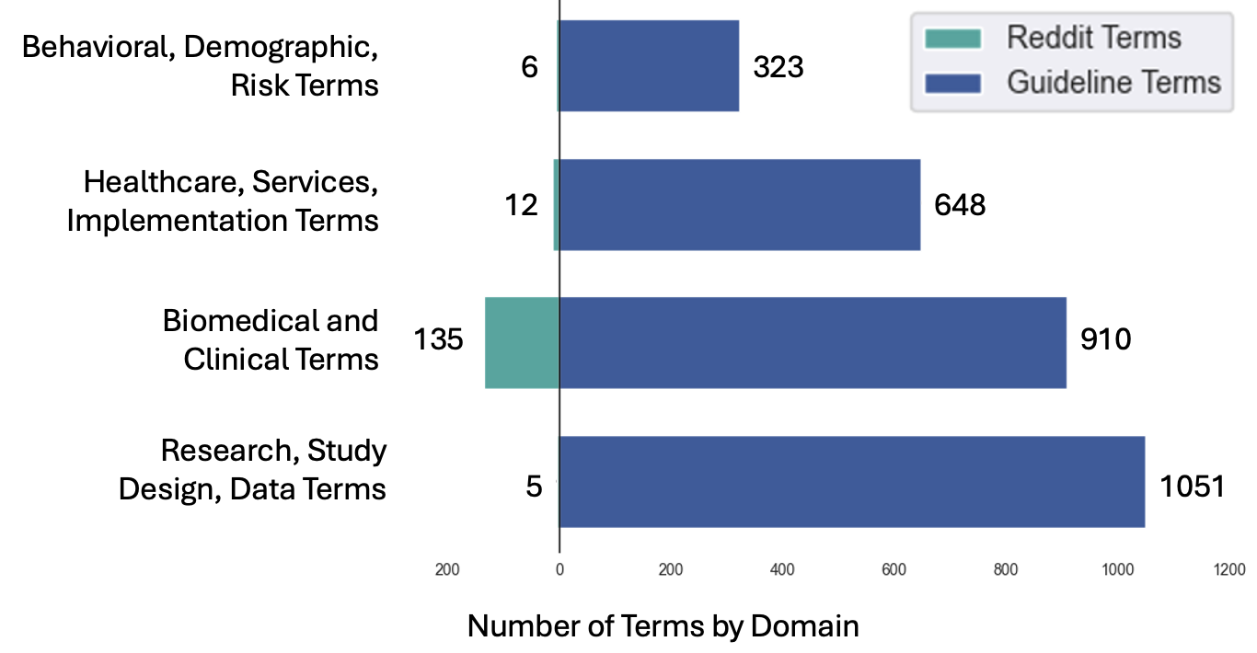

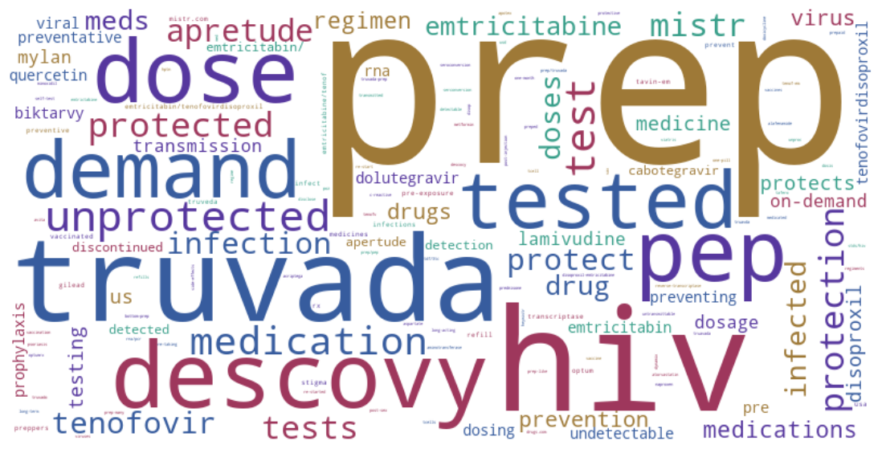
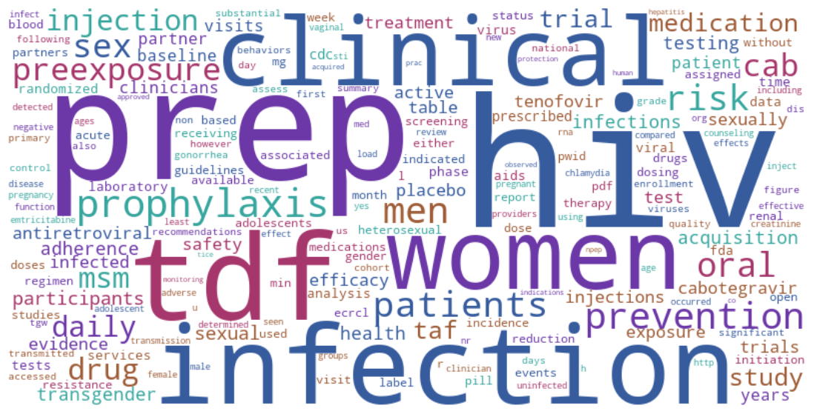
Mining Social Media for Barriers to PrEP Uptake and Persistence in the U.S.
Madelyn Carlson¹, Rasheeta Chandler², Abeed Sarker³, Jessica M. Sales¹
¹Department of Behavioral, Social, and Health Education Sciences, Rollins School of Public Health, Emory University, Atlanta, GA, ²Nell Hodgson School of Nursing, Emory University, Atlanta, GA, ²Department of Biomedical Informatics, Emory University School of Medicine, Atlanta, GA
Background
Methods
The CDC guidelines contained 4350 unique words. The most frequently used words were “hiv” (N=829), “prep” (N=594), “infection” (N=261), and “cabotegravir” (N=73). See Figure 2. We found that N=50 (out of 159) terms from the Reddit data were present in CDC Guidelines.
We thematically categorized the terms from Reddit and the CDC guidelines into four domains: 1) biomedical and clinical terms (N=1045 terms in both data sources), 2) behavioral, demographic, risk factor terms (N=329), 3) research, study design, data terms (N=1056), and 4) healthcare, services, and implementation terms (N=660).
These were plotted in a population pyramid to visualize the distribution of terms in each dataset. See Figure 3. Chi square statistic of the differences in the distribution of terms by domain in the datasets: Chi-square statistic 200.18 (p-value <0.05).
A major barrier to pre-exposure prophylaxis (PrEP) uptake and persistence in the US is the uncertainty regarding PrEP (e.g., uncertainties regarding costs, side effects, details of the drug regimen), among the public, many of whom turn to the Internet for information about it. Thus, their online posts and discussions provide insights into the public’s knowledge gaps regarding PrEP.
To identify those gaps, we conduct an innovative, community-driven natural language processing (NLP) analysis guided by the co-creating knowledge translation framework.
Our objective is to examine five years of data from Reddit and Google (2019-2024) and a) assess the public’s knowledge gaps as well as the barriers and facilitators to PrEP uptake and persistence at the population level, and b) compare the results of the community-driven NLP analysis with the CDC 2021 PrEP Clinical Practice Guidelines to identify consistencies and discrepancies between the language laypeople use when discussing PrEP and the information they seek versus the information provided in the guidelines.
As a first step, in this analysis, we examine the PrEP-related language in a subset of Reddit data (r/prep) and compare it to the CDC PrEP guidelines. Our research question: What terminology does the public use to refer to PrEP? What jargon and synonyms do people use for PrEP?
Reddit data were downloaded from r/prep (https://www.reddit.com/r/prep/), Jan-Dec 2024 using the PRAW application programming interface. The CDC PrEP Guidelines were downloaded from cdc.gov as a PDF.
Preprocessed data by tokenizing posts. The NLP Bag-of-Words (BoW) technique treats datasets as “bags” of words, producing lists of unique words from Reddit and the CDC guidelines. We manually reviewed these lists to identify and extract all terms synonymous with PrEP (i.e., the PrEP-related lexicon)
Examined terms from the lexicon Reddit and guidelines to quantify the words the public uses to refer to PrEP on Google and Reddit and generate descriptive statistics on their frequency.
We found the common terms between Reddit and CDC datasets, then compared their distributions through density plots for each set and conducted a chi-square test to assess differences, considering results significant at α = 0.05.
Figure 3. Population Pyramid Plot Terms Per Domain from Reddit and CDC Guidelines
Domains:
Results
In the Reddit data from r/prep, most common used terms were “prep” (N=298), “hiv” (N=76), “truvada” (N=74), “descovy” (N=40), “mistr” (N=15), “apretude” (N=14). See Figure 1.
Conclusion
Figure 1. Reddit Terms Used
Figure 2. CDC Guideline Terms Used
There is a statistically significant difference in how the terms are distributed across categories between Reddit and CDC Guidelines.
Next, we will qualitatively assess data to identify consistencies and discrepancies between the language laypeople use when discussing PrEP and the information they seek versus the information provided in the guidelines.

